Slide 2
The Business of Dentistry
Avitus Dental Management Solutions
Created by Avitus Dental

Slide 3

Kim McCleskey
Director of Avitus Dental | kmccleskey@avitusgroup.com | 303.557.7754
Kim is a dental practice consultant with over 25 years of experience administering and leading large dental practices.
She is a certified Professional Business Coach, member of the Academy of Dental Management Consultants and Fellow with the American Association of Dental Office Managers.
Kim has managed individual practices as a Practice Administrator and overseen multiple practices as Director of Operations.
Kim specializes in practice management, strategic business planning, leadership coaching, team development and acquisitions.
Meet Your Instructor

Slide 4
3-Step Process to Ensure Financial Accountability in Your Practice
Do What’s Right, Not What’s Easy!
STEP ONE
Recruitment
Hiring correctly
Background checks
Communication with colleagues
STEP TWO
Having and using the systems
Daily deposit balancing
Reconciling QuickBooks The Bank/ Dental Software
End of Day Review
STEP THREE
The Eagle Eye
Team knows the systems
Monthly Financial Accountability Worksheets for Manager
Monthly Financial Accountability Meeting Review

Slide 5
Step One
Recruitment
Hiring correctly
Background checks
Communication with colleagues

Slide 6

Hiring Correctly
Step One
Hire for skill and character:
High character vs Low character
Have your training process established and in writing
Encourage & Empower through building a culture that is rooted in core values

Slide 7

Background Checks
Step One
Always, Always, Always
run a background check

Slide 8

Vet Every Applicant
Step One
Check with you dental colleagues
Involve your team in the hiring decision
DON’T SETTLE – listen to your gut!

Slide 9
Step Two
Having and Using the Systems
Provider End of Day Review Folder
Team needs to be trained on the Daily Systems of writing up a deposit
and preparing the End of Day Folder.
Reviewing Instructions for Provider
Preparing the Deposit Slip
Monthly Financial Accountability Reports needed to Reconcile QuickBooks
to Your Dental Software.

Slide 10

Provider End of Day Review Folder
Step Two
At the end of each day the folder is placed on the doctor’s desk with the contents from the following check list.
01. Master Schedule
Noting cancellation/ Rescheduled?
No Shows/Rescheduled?
Same day treatment added

Slide 11
Provider End of Day Review Folder
Step Two
02. Computer Reports
Day Sheet by Provider
Adjustments Day Sheet
Number of New Patients Scheduled that day- noting how they were referred
Deposit Slip that shows each type of payment
Bank Deposit slip prepared listing check totals, cash totals, credit card totals and 3rd party totals
Insurance Explanation of Benefits (EOBs) posted that day

Slide 12

Provider End of Day Review Folder
Step Two
03. Refund Request
Patient and Insurance refund request with copy of EOB and ledger printout indicating reason for refund. The doctor will review for accuracy and deliver to bookkeeper to issue refund.
Attach Patient Refund Request Form. Once the bookkeeper has issued the check the refund request form is returned to the front desk to make the adjustment in the dental software.
The refund will be reconciled during month end balancing.

Slide 13

Provider End of Day Review Folder
Step Two
04. Print Patient Care Call / or
Call back list for Dr.
Include patient phone and email contact information.
05. Print out the list of NP due
tomorrow
Include phone number and reason for visit and any other important information that will be helpful for the doctor to know.

Slide 14
Reviewing Instructions for Provider
Step Two
01. Production
Review the Day Sheet by provider with the Master Schedule. Look for any discrepancies, errors or changes that need to be made to completed procedure entries. Flag any changes.
If no changes are necessary each provider initials their production totals on the Day Sheet.
02. Adjustment
Review Adjustment Day Sheet for any mislabeled or unusual looking adjustments. Inquire about such items. Use insurance EOBs when necessary to confirm proper insurance posting practices.

Slide 15
Reviewing Instructions for Provider
Step Two
03. Refunds and Credits Balances
Refunds to patients and insurance companies must be shown on the Adjustment Day Sheet. Refunds must be documented and the evidence approved by doctor. Reminder- accounts must be reconciled with the EOBs prior to issuing a refund.
04. Wrap up
Return the Folder to the administrative desk after review. If no revisions are necessary the doctor signs off by initialing documents in the lower right corner. If revisions are necessary updated copies are returned to the doctor’s desk in the Folder for final review. The Folder must include the original document as a reference. Documents are then filed by day and month in a 3-inch binder.

Slide 16
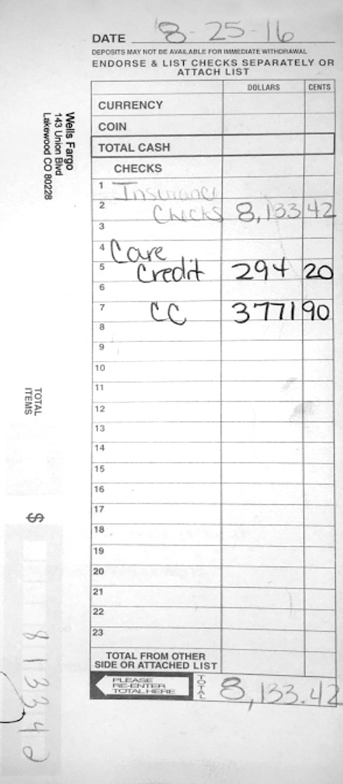
Prepare Bank Deposit
Step Two
Print deposit from dental software
Add up total checks entered into the dental software for the day (show your work or write up each check in the deposit book as you go) - Balancing to Dental computer system deposit.
All credit card slips including total batched amount matching dental software deposit slip.
All cash received with a note stapled to each payment listing the patient’s name and total amount paid- indicate if change is due back to the office cash box so the Dr. will know to bring it back.
Copy of third party financing, Care Credit, Spring Stone, etc.
When Dr. returns with receipt of deposit staple it to the carbon copy in the deposit book.
The bookkeeper will refer to the deposit book to make entries into QuickBooks.

Slide 17
Monthly Financial Accountability Reports Needed to Reconcile QuickBooks to your Dental Software.
Step Two

Slide 18
Checklist to Balance QuickBooks to Dental Software
Step Two
After the bookkeeper has balanced the previous month bank statement have the bookkeeper run the following reports from QuickBooks. Front desk will run corresponding reports from dental software.
Patient Collection Report
Patient Refund Report
Insurance Refund Report
Care Credit/or Other 3rd Party Fee Report
Merchant Credit Card Fee Report

Slide 19
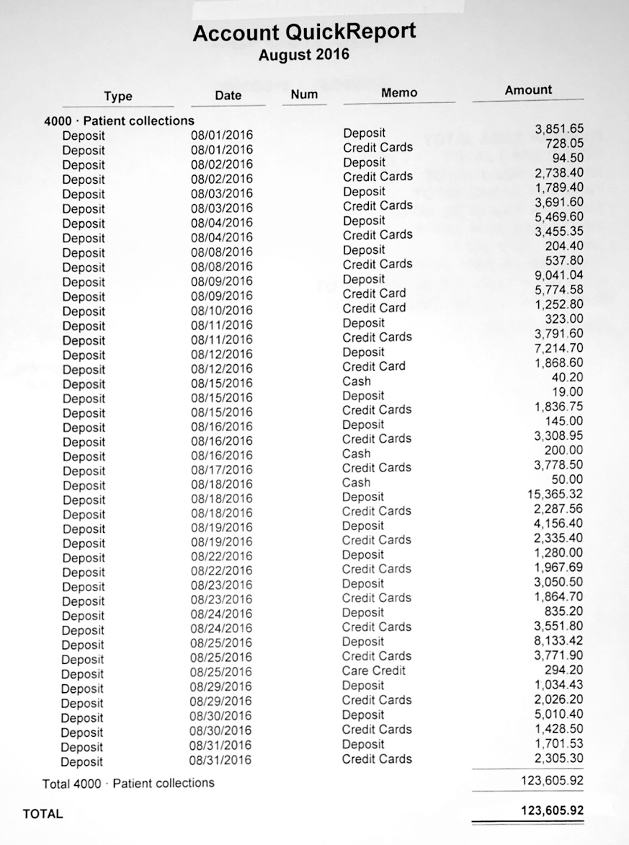
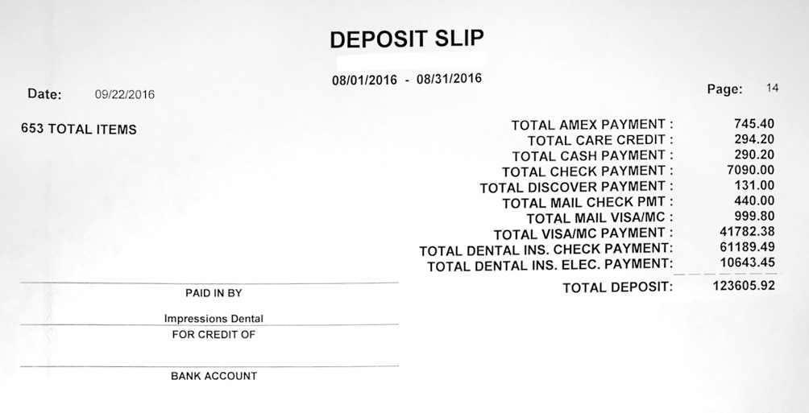
Patient Collection Report
Checklist to Balance QuickBooks to Dental Software
Make separate entries for cash, checks, Care Credit and credit cards.
Make sure the date the funds were entered into dental software match the date entered into QuickBooks.
Balance with dental software.

Slide 20
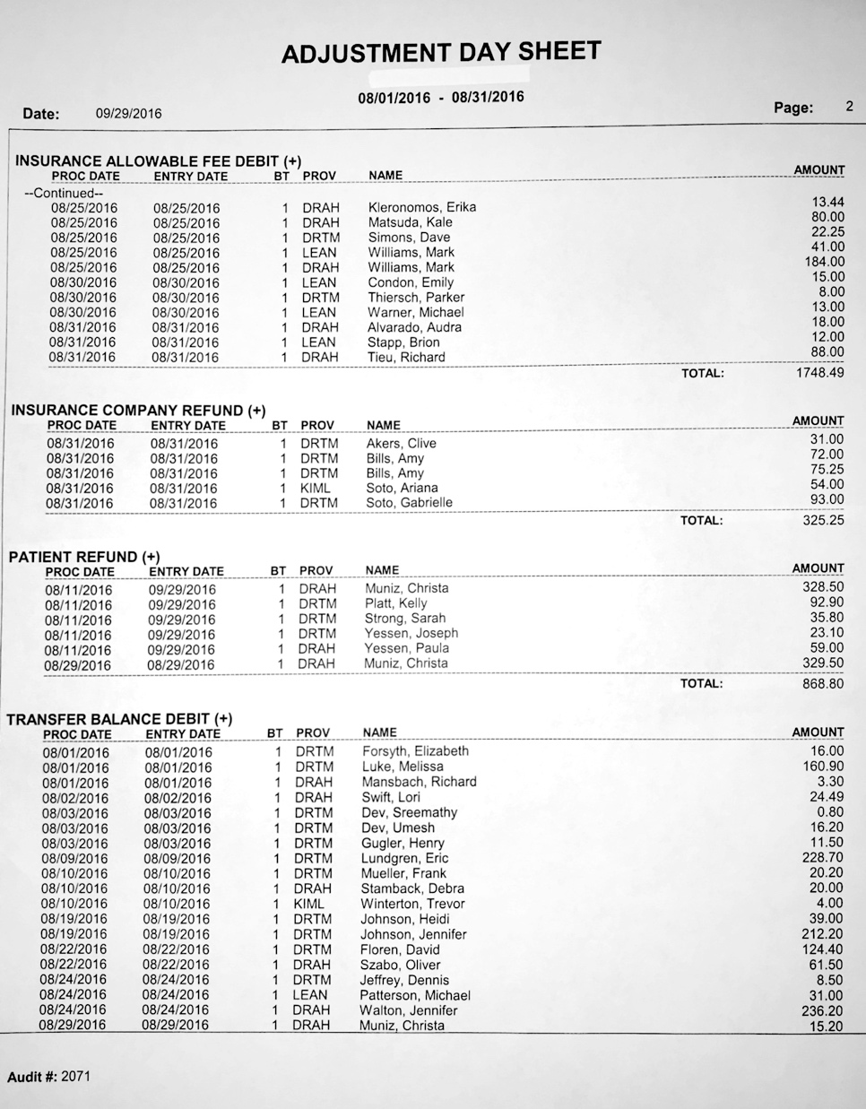
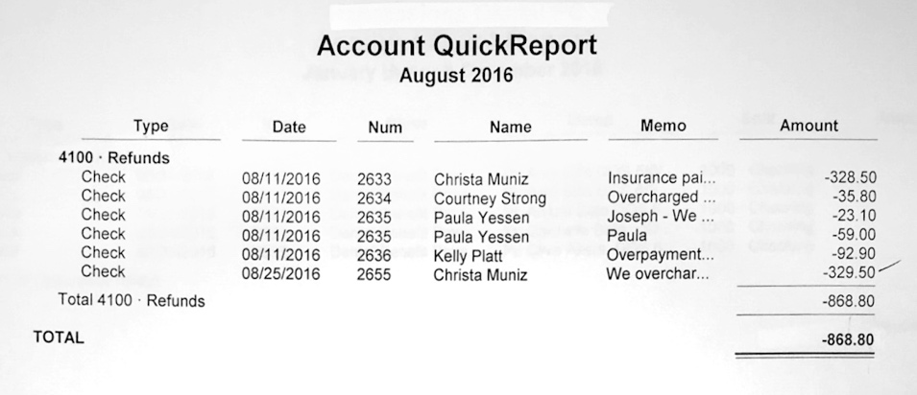
Patient Refund Report
Checklist to Balance QuickBooks to Dental Software
Run the patient refund report in dental software to be sure the adjustment was entered into the patients ledger and reconciles with QuickBooks.
Note: Have the bookkeeper reference the patient first initial and last name in the memo box on the refund check.

Slide 21
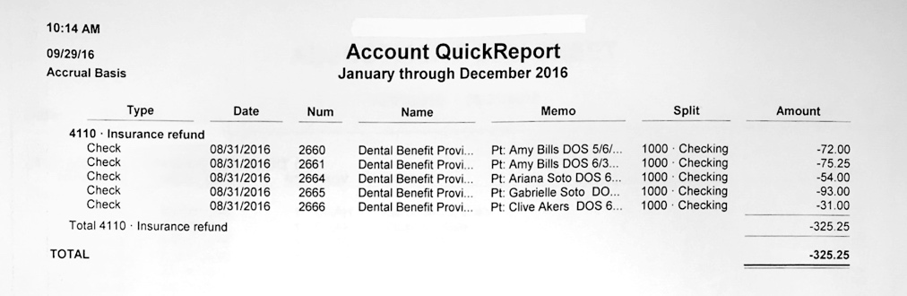
Insurance Refund Report
Checklist to Balance QuickBooks to Dental Software
Run the patient refund report in dental software to be sure the adjustment was entered into the patients ledger and reconciles with QuickBooks.
Note: Have the bookkeeper reference the patient first initial and last name in the memo box on the refund check.

Slide 22
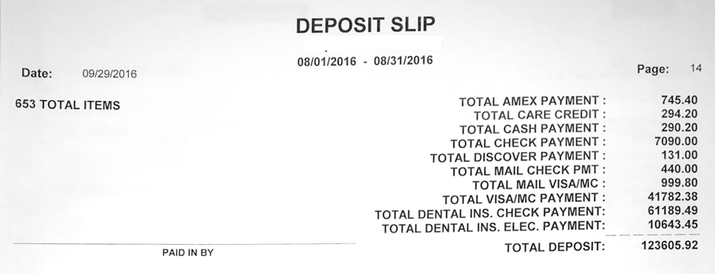
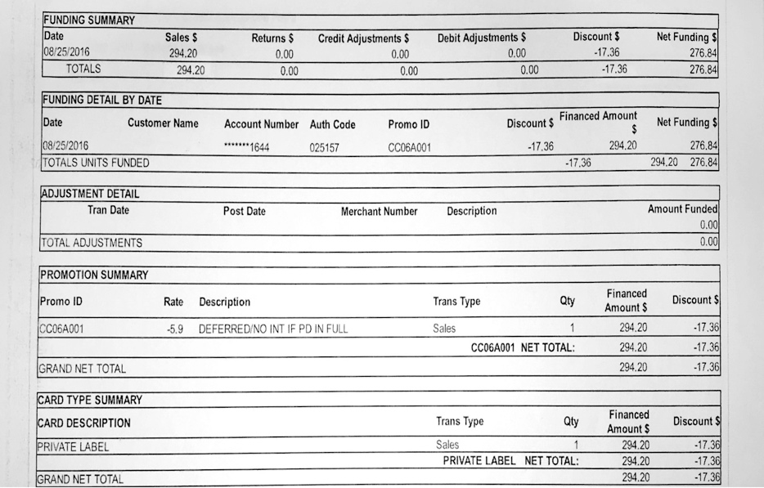
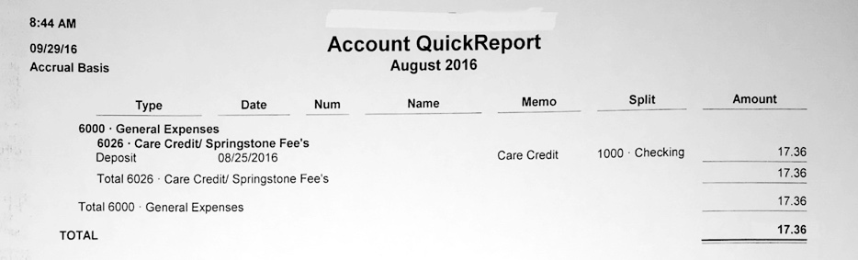
Care Credit Audit
Checklist to Balance QuickBooks to Dental Software
Note: At the first of the month have the front desk run a Care Credit “Daily Funding Report” report showing fee’s and net funding deposited into the bank - so that the bookkeeper is able to subtract the fee from the care credit amount entered in QB (which is the amount the patient paid and is needed to balance patient collections with dental software) compare your daily funding report to your QB Care Credit fee report.

Slide 23
Merchant Credit Card
Fee Report
Checklist to Balance QuickBooks to Dental Software
This is a reconcile fee withdrawn from the bank with merchant statement and credit card totals from your dental software.
Note: Make sure to reconcile your dental software Credit card deposits to the bank and double check that the fee on the statement was correctly debited from your account.

Slide 24
Are We Balanced?
Checklist to Balance QuickBooks to Dental Software
These numbers must match the month end deposits entered into
your dental software to the penny.
01. If they do balance; Your system software and money in bank balance.
02. If they don't balance;
Reprint your deposit slip by payment type;
Balance each payment type with your QuickBooks deposit
Cash (this must be balanced every day and should be written up on a separate deposit ticket)
Checks (this must be balanced every day before taking to bank)
Insurance checks (this must be balanced before taking to bank)
Credit card payments (balance daily and balance against CC statement)
Care Credit payments (balance bank against Care Credit Statement minus fee’s)

Slide 25
Step Three
The Eagle Eye
Checklist for Monthly Financial Accountability Meeting
Monthly Accountability Worksheet for Manager/front desk
    Review Reports with Doctor
    Review P & L expense percentages
    Review Detailed P & L to look for expense inconsistencies
Monthly Financial Accountability Meetings are Scheduled a month in advance

Slide 26
Checklist For Monthly Financial Accountability Meeting
Step Three
After the bookkeeper has balanced the previous month bank statement
have the bookkeeper run the following reports from QuickBooks.
Front desk will run corresponding reports from dental software.
Patient Collection Report
Patient Refund Report
Insurance Refund Report
Care Credit/or Other 3rd Party Fee Report
Merchant Credit Card Fee Report
Managers Monthly Accountability Worksheet
Proof of QuickBooks Reconciliation Report and the Bank Statement ending balance match
Tracking Monthly Overhead Expenses and Revenue Projections

Slide 27
Managers Monthly
Accountability Worksheet
Step Three

Slide 28
Office Manager Monthly
Practice Analysis Worksheet
Monthly Accountability Worksheet for Managers

Slide 29
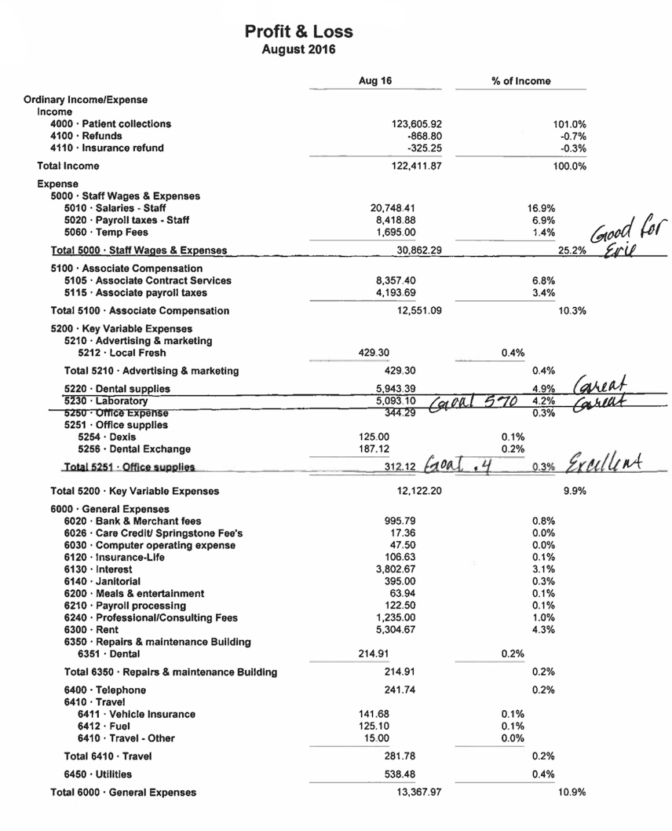
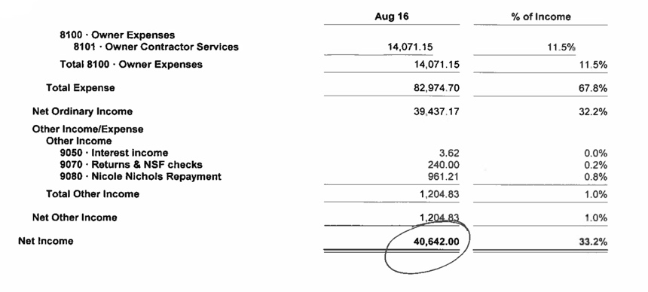
Overview of Profit and Loss Report
Step Three
Pay attention to industry-standard Percentages for your Overhead Expenditures.
Wages 22% - 27%
Dental Supplies 4% - 9%
Lab Fee’s 5% - 9%
Office Supplies .4%
Marketing 4% - 10%
Rent 10%

Slide 30
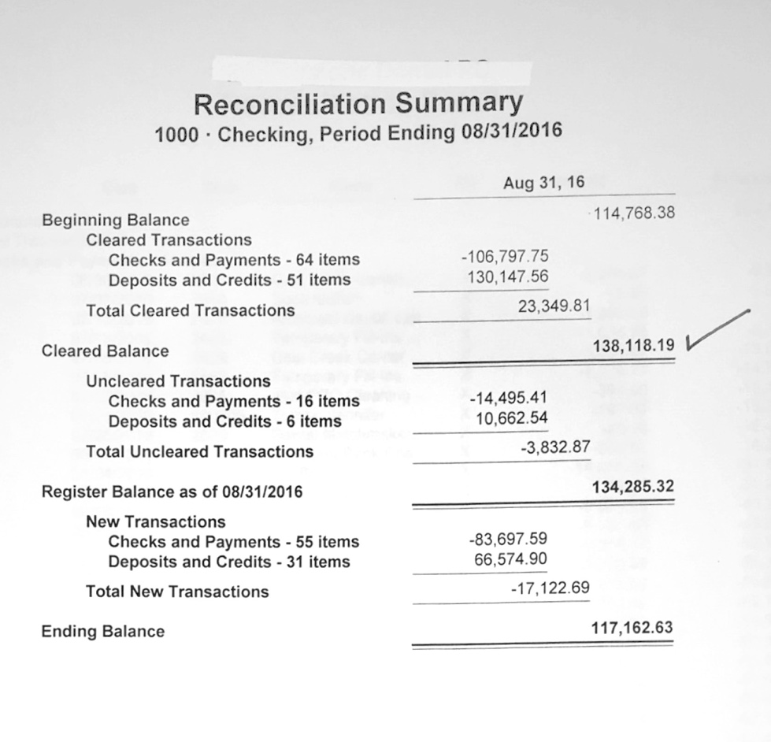
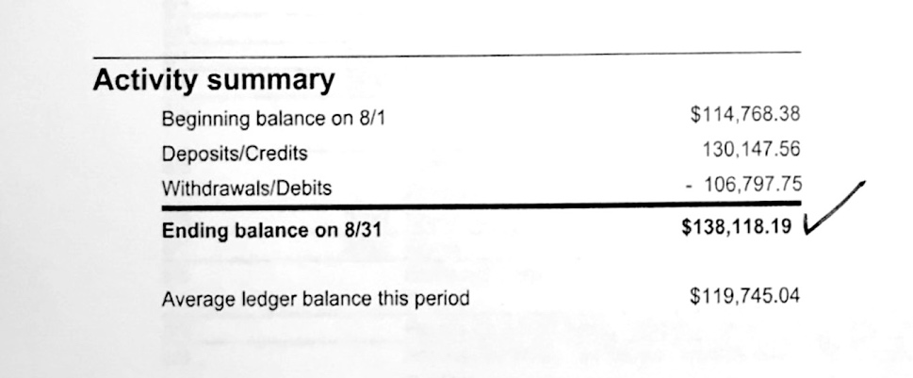
Reconciliation Report
Step Three
Note: If accountant is reconciling your bank statement make sure they provide the final balanced report. Make sure the accountant is willing to work with you to insure your bank and dental software are reconciled.

Slide 31
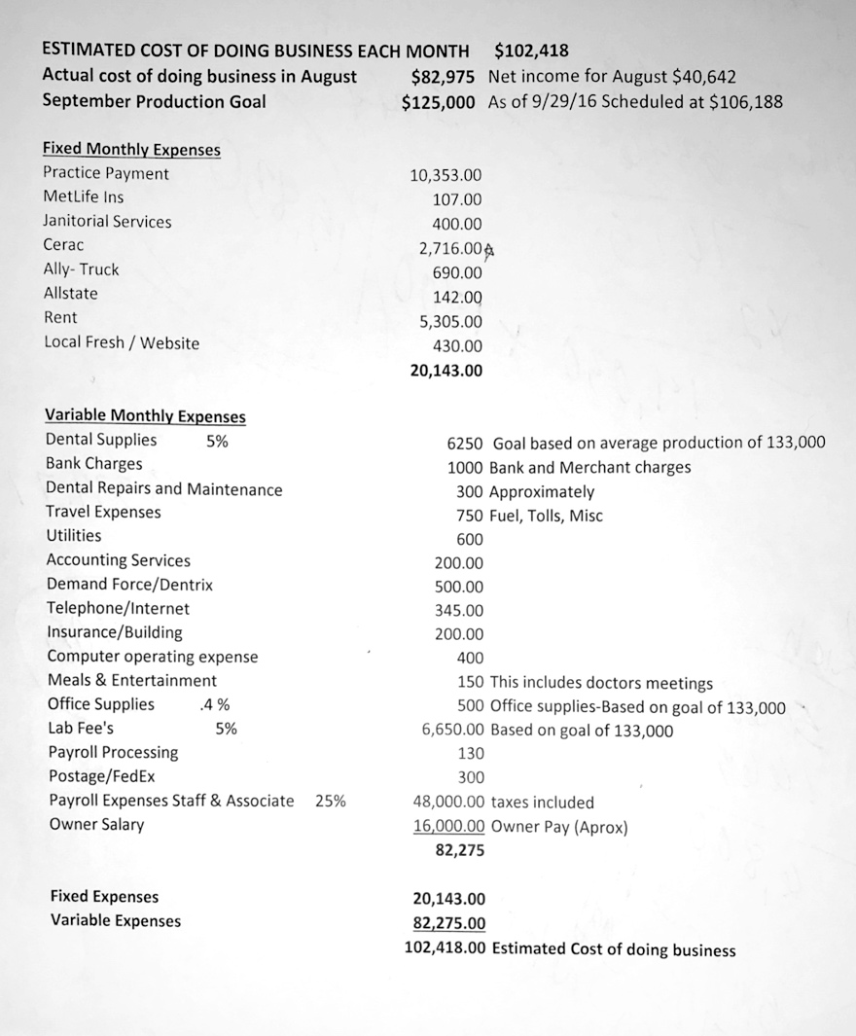
Sample: Tracking Monthly Expenses and Projected Profit
Step Three

Slide 32
THANK
YOU
Avitus Dental Management
Payroll Administration
Accounting
Tax Planning & Preparation
Human Resources
Benefits Administration
Co-Employment
Safety & Risk Management
Recruiting
Branding & Marketing
Information Technology
Professional Acceleration
Insurance Services
Kim McCleskey | Director of Avitus Dental
kmccleskey@avitusgroup.com
303.557.7754

